Slide 1
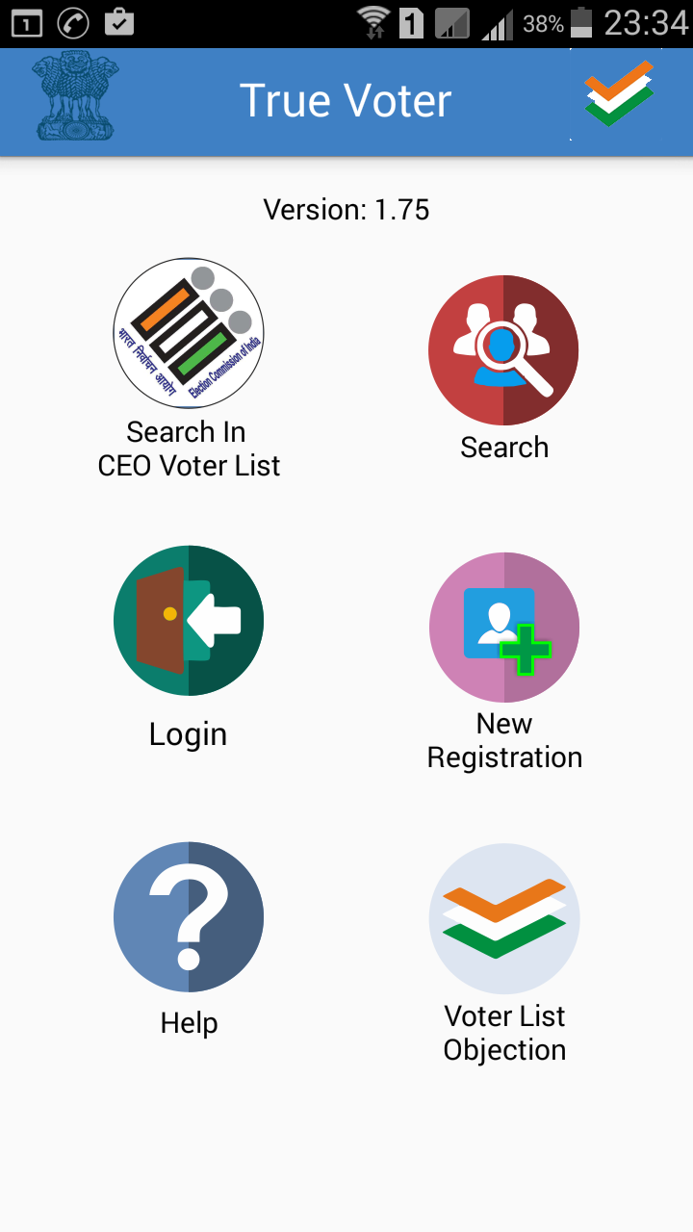
True Voter version 1.75
Download True Voter App from Play Store and Open it in your app.
This is the first basic home screen of the app
1. Search in CEO Voter List : This is to search your name on CEO Site through app. Follow the steps given in it for District wise and name wise search
2. SEC Search : It is used to search your name in SEC voter list as per going on Current Local Body Elections only.
3. Login : It is to be used when u register as a True Voter, Officer or as a Candidate
4. New Registration : It is to be used one time only when u have to register your self either as a Voter/ Officer/ Candidate
5. Help : FAQ, user manual, Videos are given to understand use of True Voter app
6. Voter List Objection : It is used to take objection on draft Voter List before election

Slide 2
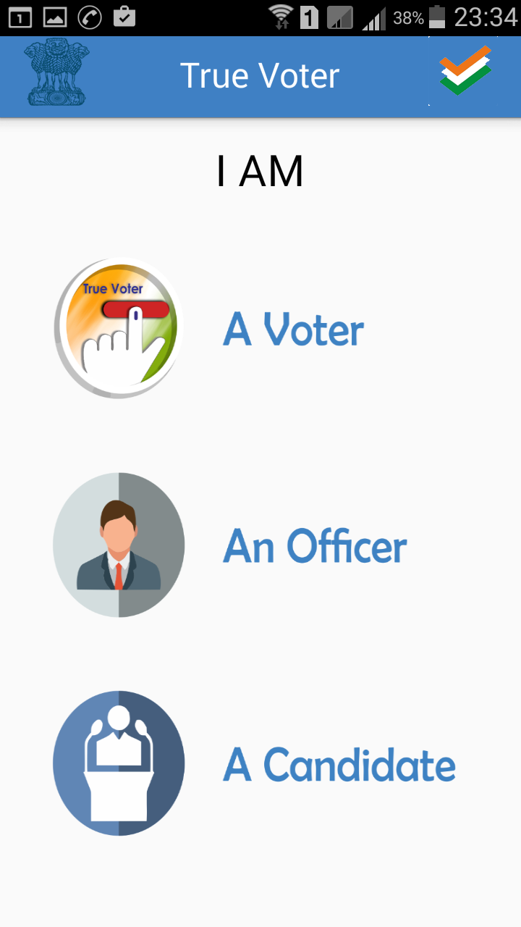
True Voter version 1.75
Every one is having a right to use True Voter app
He can use it in three Different Roles as per his requirements
1. A s A Voter : Any person having his name in Maharashtra State Election Commission List can register as a True Voter for many personal and general purpose.
2. As An Officer : All officials involved in Maharashtra State Election Program through out the state in various roles have to register as “An Officer”
3. As A Contesting Candidate and His Representative : All Contesting Candidates of the currently going on election has to register to fill their daily election expenses and their representative can also optionally use it.

Slide 3
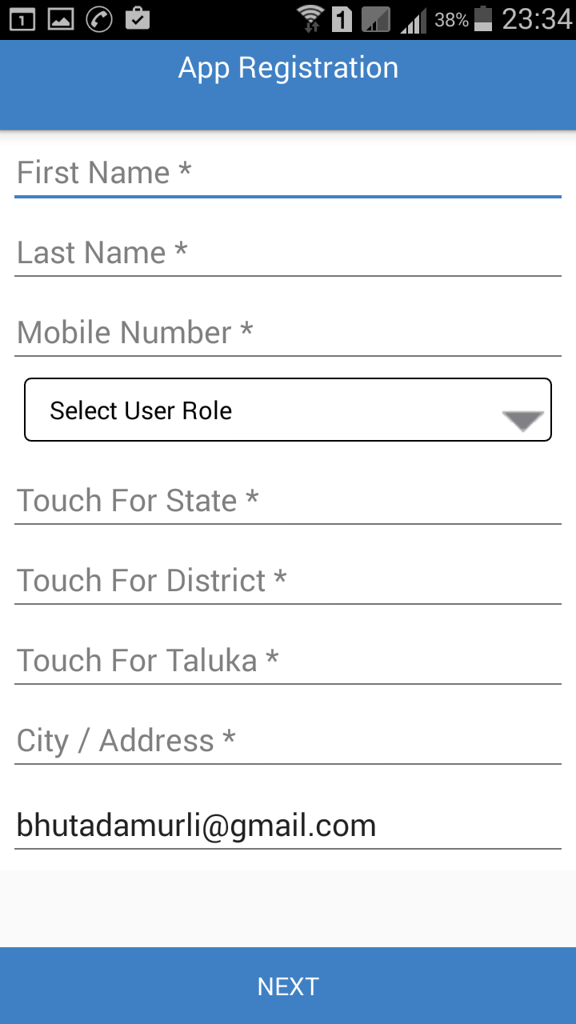
True Voter version 1.75
True Voter App registration is only required for Officers and Candidates with their representatives also if required.
Its must to fill some basic information with your mobile no, which will be verified further by OTP. So use your proper mobile no in registration.
Touch at every field to fill relevant information.
Select either Officer/Candidate role as per your work
You have to just touch to select State from the list, Touch to Select District as well as touch to select your Taluka from the given list.
Type your proper address with City/Town/Area name in “City/Address” field.
By default your email id will be picked up from ur mobile play store, correct it if required.

Slide 4
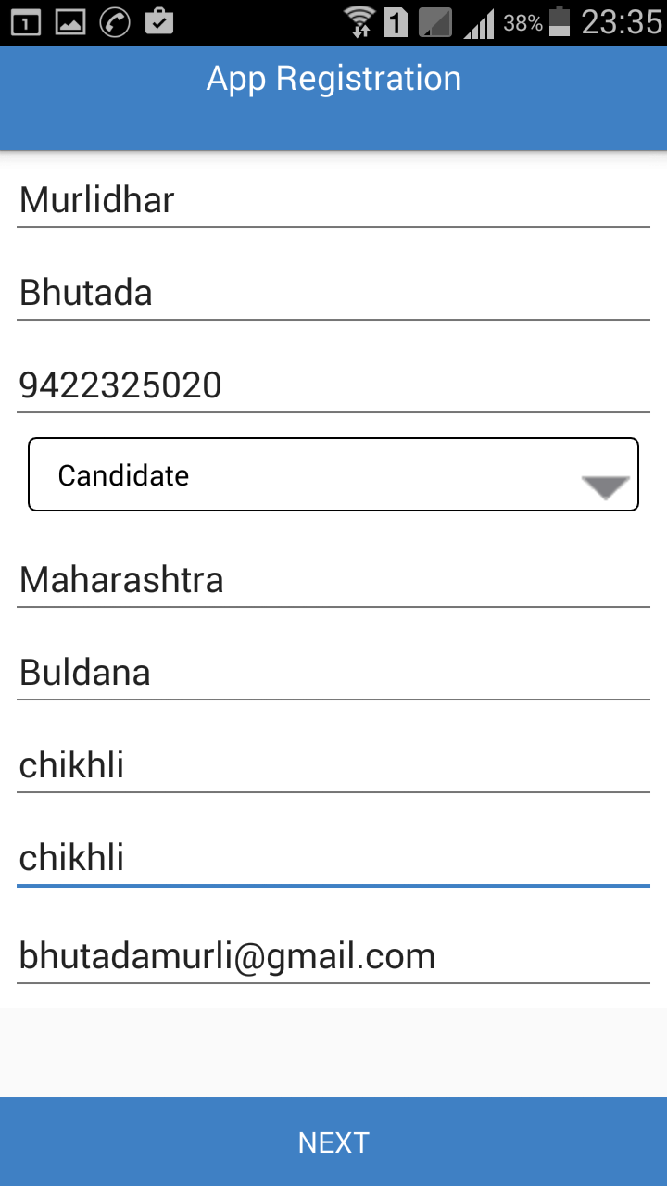
True Voter version 1.75
Sample of complete app registration is given herewith in a candidate role.
Use your own 10 digit mobile no properly to get verified further by OTP.

Slide 5
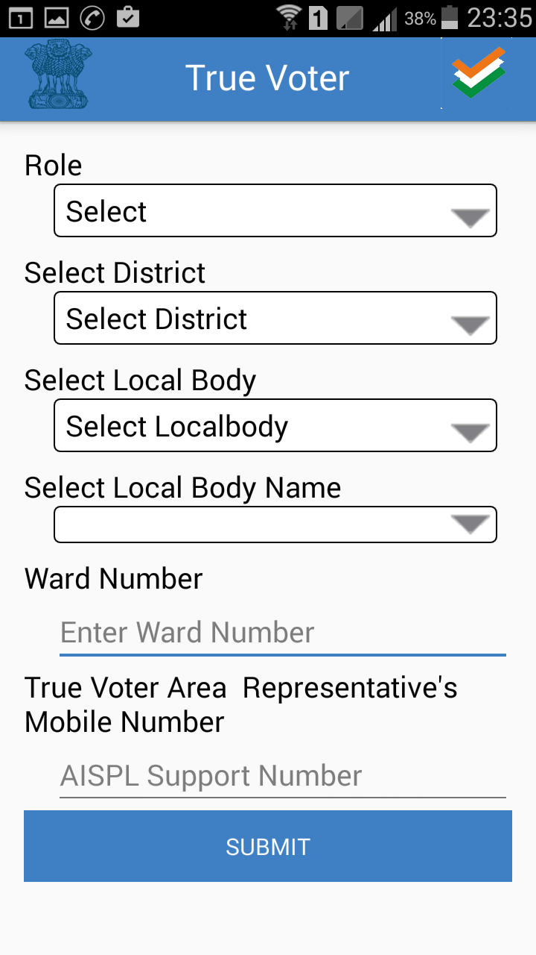
True Voter version 1.75
This is the second page of app registration. Here you have to specify the purpose of using this app.
This app can be used when you are going to contest any Local body election.

Slide 6
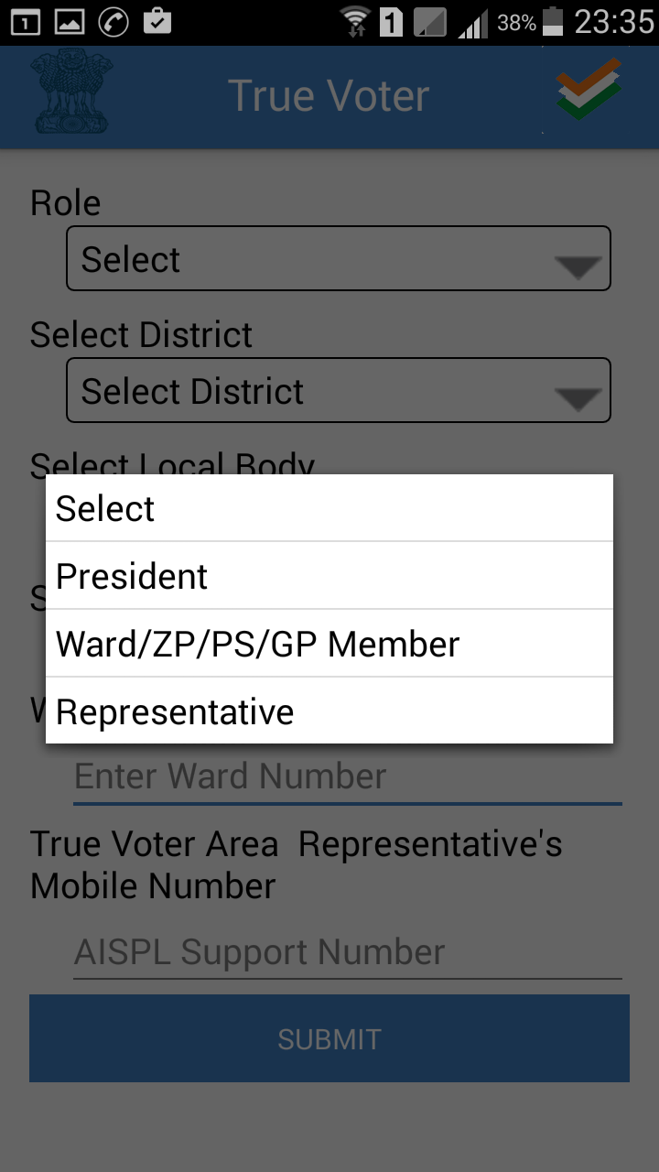
True Voter version 1.75
Select Proper Role in which you have to use this app.
There are 3 roles 1) President : It is only applicable if you are contesting for President Post in Election type = “Municipal Council”. In all other types it is not applicable. 2) Ward/ZP/PS/GP Member : For all types of elections this is applicable. All contesting candidates of Corporation, Zilla Parishad, Panchayat Samiti should use this role. 3) Representative : This is completely optional. If a candidate wants to use his supporting Staff/Workers/ Volunteers to use True Voter App for sharing of work then his concern all Staff should use this option. Candidate has to add their mobile nos first in his app as a representative nos.

Slide 7
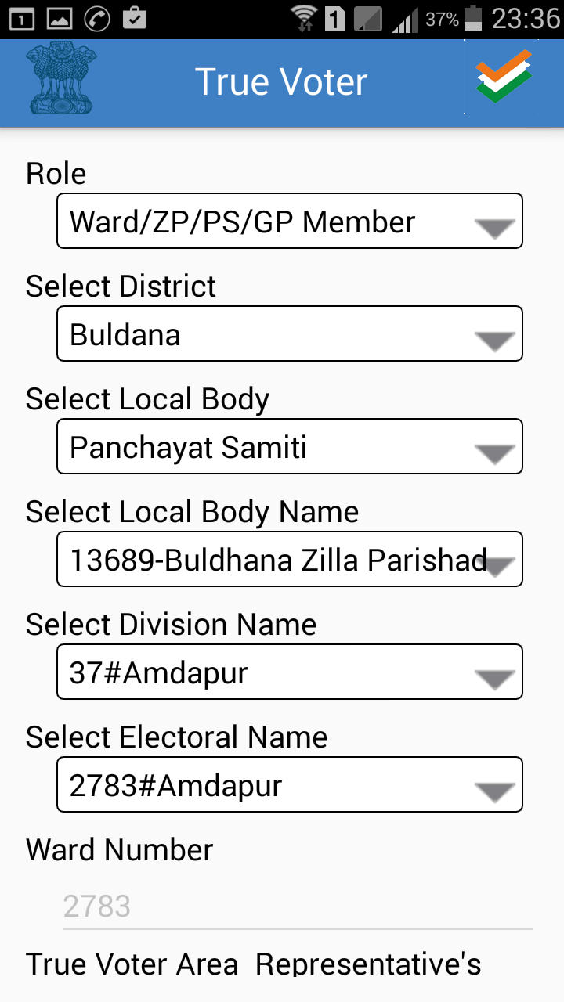
True Voter version 1.75
In side screen a sample of Panchayat Samiti member selections is given.
Select a proper role as a member.
Select your District in which you are going to contest election
Select proper election type. There are total 6 types of Local body Elections conducted by State Election Commission. Here Sample “Panchayat Samiti” is selected.
Select the Local Body name available in that district.
Select proper Division out of the list available
Select Electoral college Name out of the selected Division Name.
Add the Area representative mob no of True Voter if he come to u to give his personal services.
Press “Submit” to finish the Registration Process

Slide 8
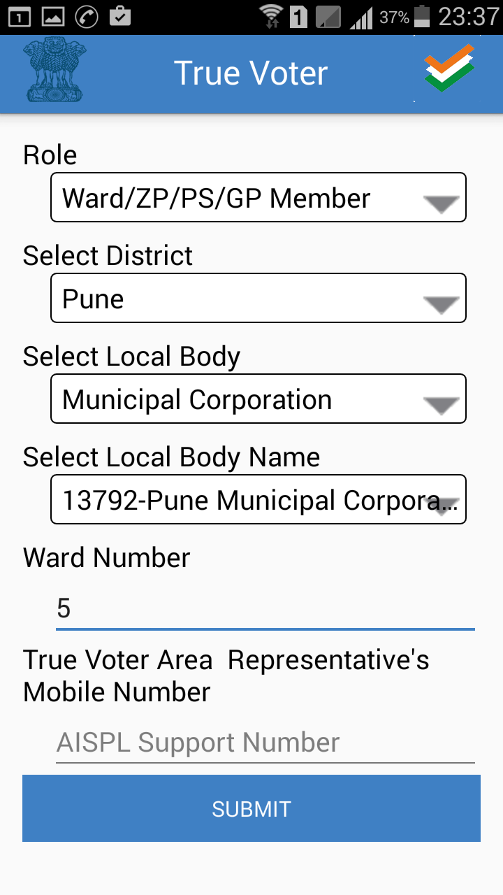
True Voter version 1.75
If you are going to use this app for Corporation Purpose then select election type as “Municipal Corporation”
Select the Local Body name of your corporation
You will have to type your related ward no, you will get complete voter list of that ward in your mobile. This is only the authentic source of getting information.
Mostly in every area Abhinav IT Solutions Pvt Ltd have their technical representative whose services you can hair. If True Voter area representative help you to use True Voter ‘s all functionality then add his mobile no as “AISPL Support No”
Press “Submit” button to finish the registration process.
You will be taken back to first Home Screen. Use Login menu to go ahead.

Slide 9
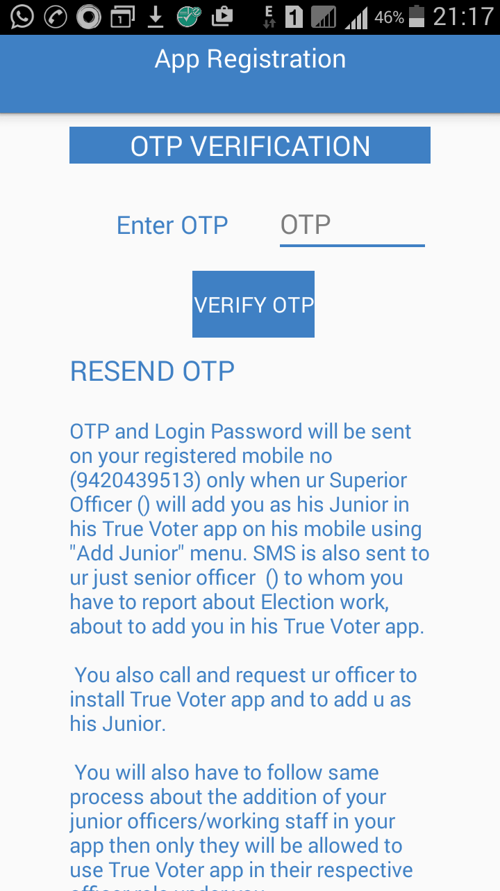
True Voter version 1.75
OTP Verification :
Licensing of app is device specific.
By sending OTP on your registered Mobile no and feeding it on the device in which you are installing app, relation between Mobile no and Mobile Handset is fixed. Change of handset for premium version use is not allowed. You are going to get the user license for specific handset only. So be careful to install on the app on proper device before going to get premium license version. It is not transferable from device to device.

Slide 10
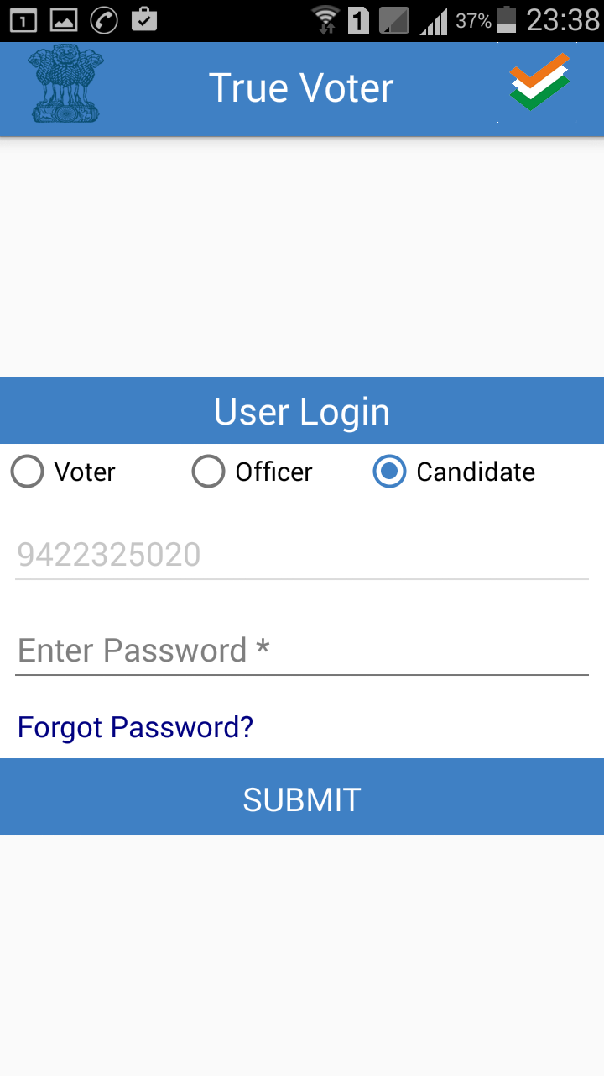
True Voter version 1.75
Login Menu :
There are three different types of login in True Voter App.
Voter login is based on Alpha Numeric user name, and it is not device dependant, as a voter you can login from any mobile any time.
Candidate Login : It is for election contesting candidates and for their representatives. Its based on Candidate Mobile No and it is supposed to be used on his single unique fix handset. Login from multiple devices is not allowed.
Officer Login : It is for all Officers and Staff members related to on going election program. Its based on officers Mobile No and it is supposed to be used on his single unique fix handset

Slide 11
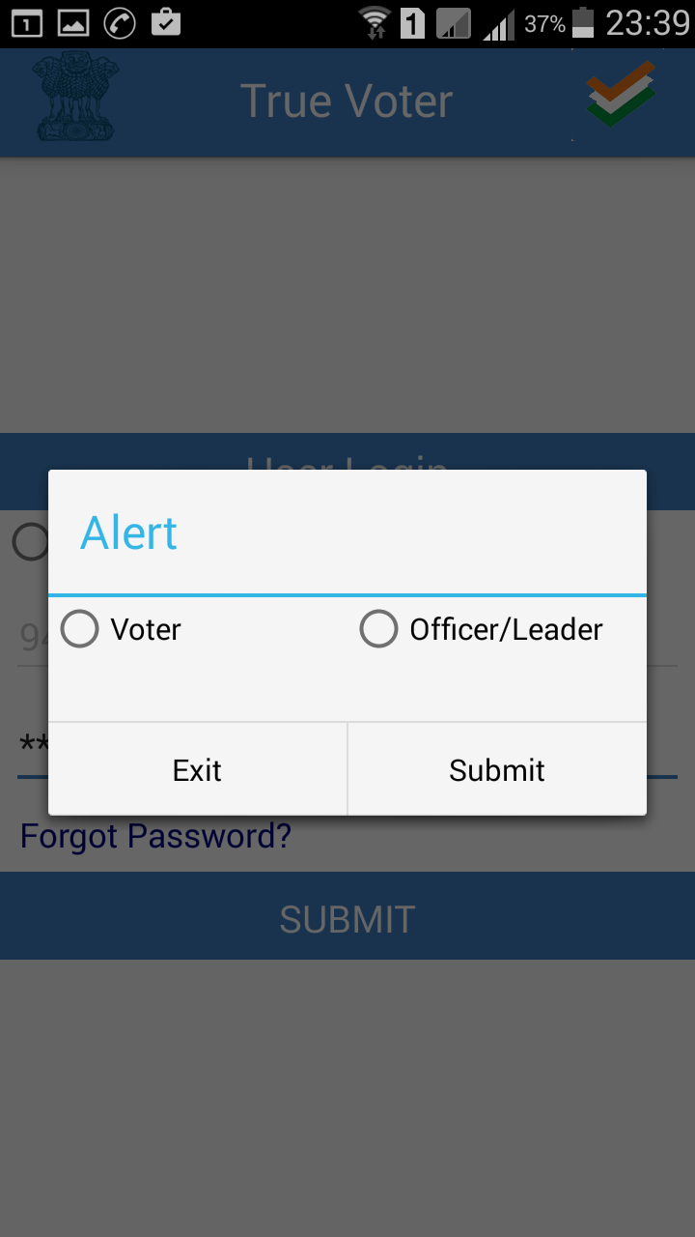
True Voter version 1.75
Forget Password :
If you forget password, you can recall on your registered mobile no.
As a voter your user name is alphanumeric, each user name is unique, it wont get repeated. More than one user name may be verified from same mobile no.
Officer and Leader registration depends on their mobile no and handset IMEI no, so one officer /leader is related to one mobile no only. They are not supposed to login various devices.
Click on Voter or Officer/Leader radio button to get the password of that role. And continue further pressing “Submit” button.

Slide 12
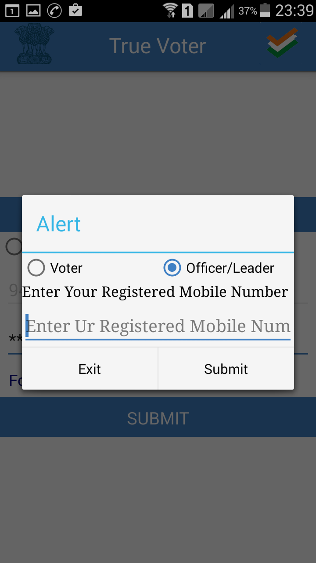
True Voter version 1.75
To Receive Password again :
To receive forgotten password in Officer/Leader role provide your registered 10 digit mobile no and press “Submit” to go ahead.
In Voter role you will have to provide user name and not a mobile no.

Slide 13
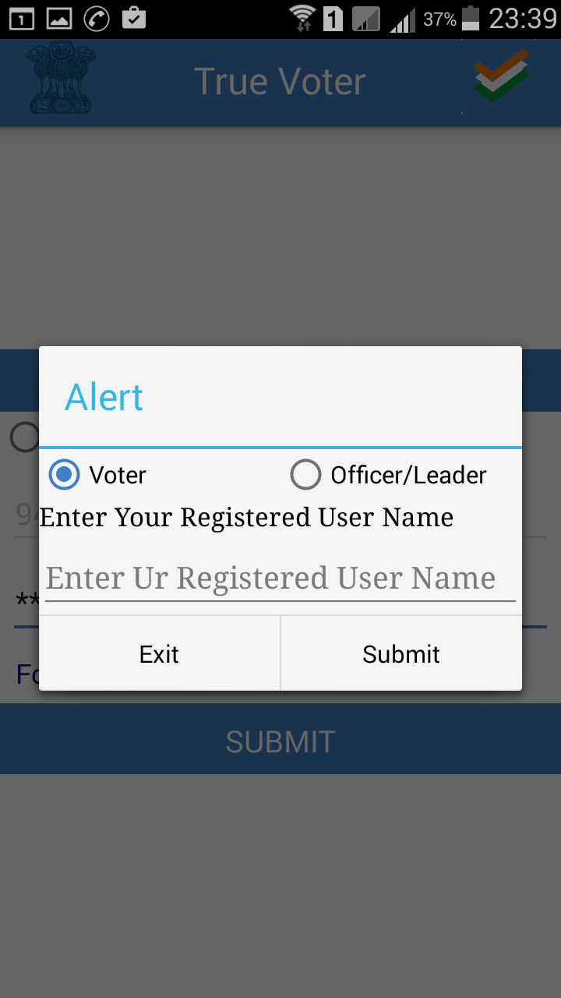
True Voter version 1.75
If you have forgotten password of your user name in voter role, use this option.
You will receive its password on your registered mobile no. it may be different than the handset on which you are using True Voter App.

Slide 14
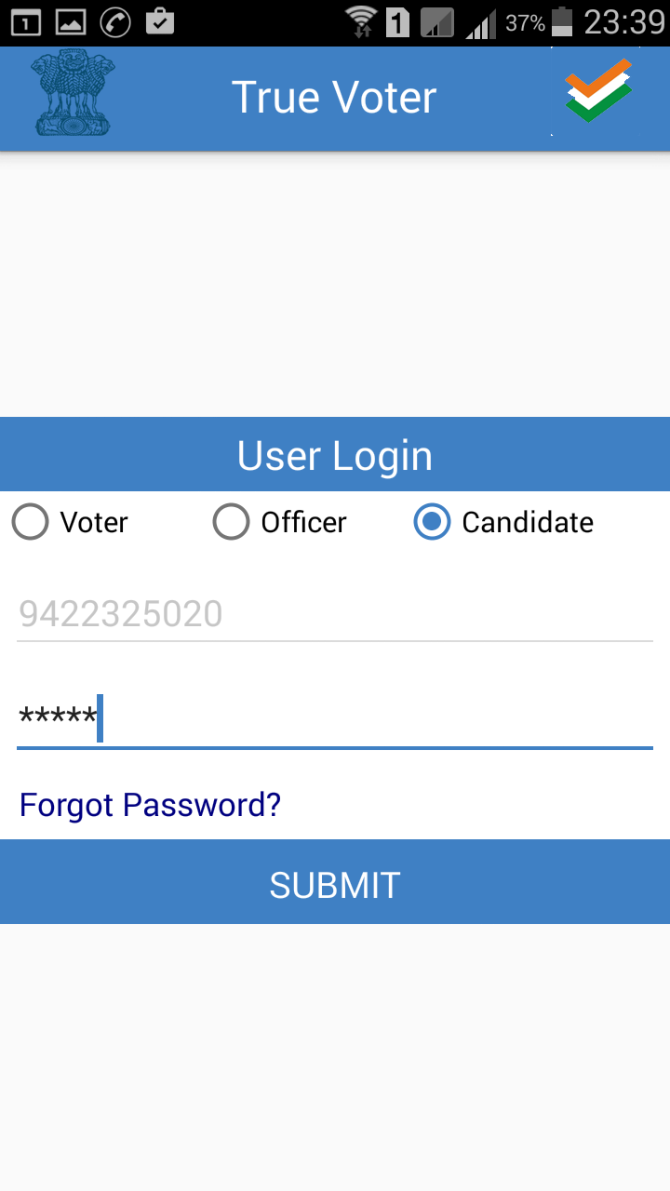
True Voter version 1.57
If you register freshly True Voter app on your mobile then after registration you come back to main menu.
Click on Login icon to login.
If you have registered as a Officer or Candidate/ Representative then automati-cally your mobile no is locked as your user name, you have just to type password to go ahead, press “Submit” to continue. Net connection is must to login.
Here sample is of Candidate registration, and screen of candidate login is shown.
It will take around 30 seconds to login. Notification about it will be displayed after pressing “Submit” button.

Slide 15
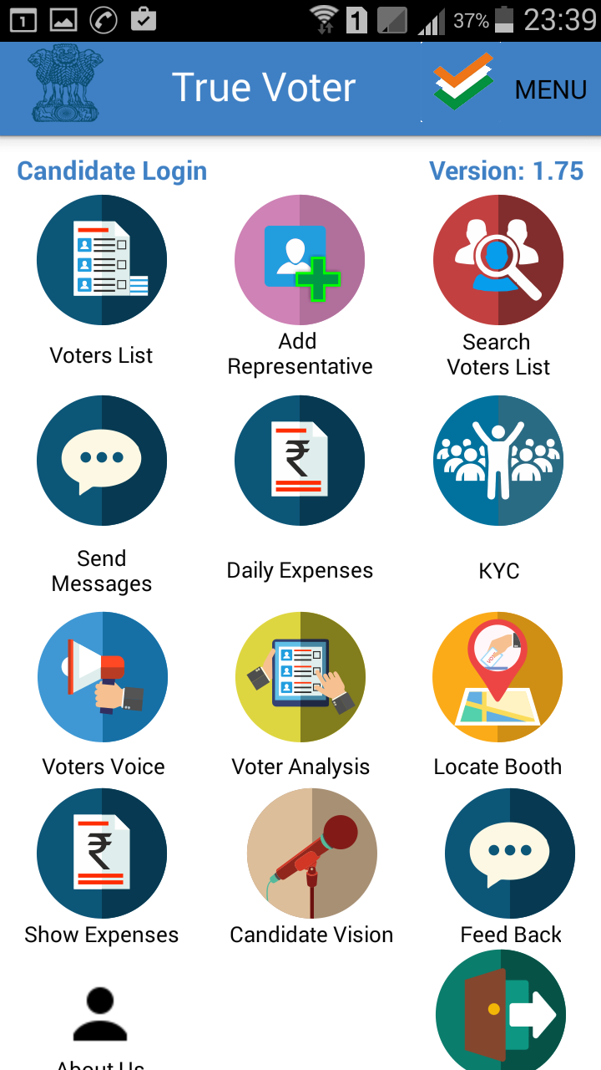
True Voter version 1.75
Candidate Login Home Screen :
There are various icons on the home screen of candidate login. At the top your login role is displayed and version no of the app is also displayed at right corner.
Whenever you will exit the app, you will be still in the login state. When you will reopen the app you will come to this screen again. You have not to logout frequently. Be in login condition, as the app is on your own mobile.
1. Voter List,
2. Add Representative,
3. SEC Voter list search,
4. Send Message,
5. Daily Expenses,
6. KYC (Know Your Candidates)
7. Voters Voice,
8. Voter’s Analysis,
9. Locate Booth,
10 Show Expenses
11 Candidate Vision
12 Feedback 13 About Us
14. Log Out.

Slide 16
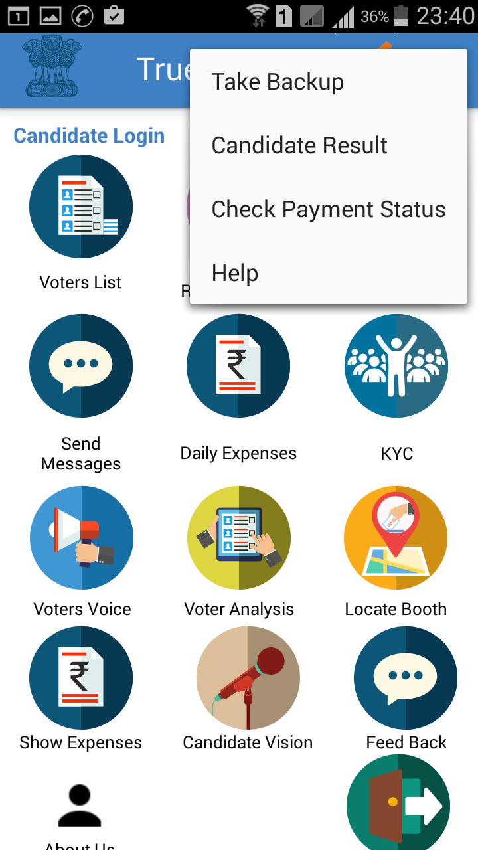
True Voter version 1.75
In upper side “Menu”
There are four options
1. Take Backup
2. Candidate Result
3. Check Payment Status
4. Help.

